Slide 1

Project Presentation on
Notice Management System
Sai Subham Pattnaik (19CSE104)
Kumar Samarjeet (19CSE111)
Mayank Gupta (19CSE115)

Slide 2
Content
Introduction
Objective
Tools Used
Project Screenshots
Conclusion and Future work
References

Slide 3
Introduction
Our project is based on notice management system. This project would help the head of the institution to ease the method of circulation of notice. It is a common portal where the message would be reaching to everyone under that institution on time.

Slide 4
Objective
The primary objective of our project is to eliminate the chaos and confusion created during circulation of the notice in the institution at different levels. For example, the head of the institution wants to circulate a certain message only to HODs of all department. There are chances that message may leak to someone else but in this portal, if the head of the institution wants to send the message to HODs only, then his message will be posted on the HODs’ dashboard only and will not be shared to other faculties or students.

Slide 5
Tools Used
HTML(HyperText Markup Language)
CSS(Cascading Style Sheets)
php(Hypertext Preprocessor)
JavaScript
SQL(Structured Query Language)

Slide 6

Project Screenshots

Slide 7
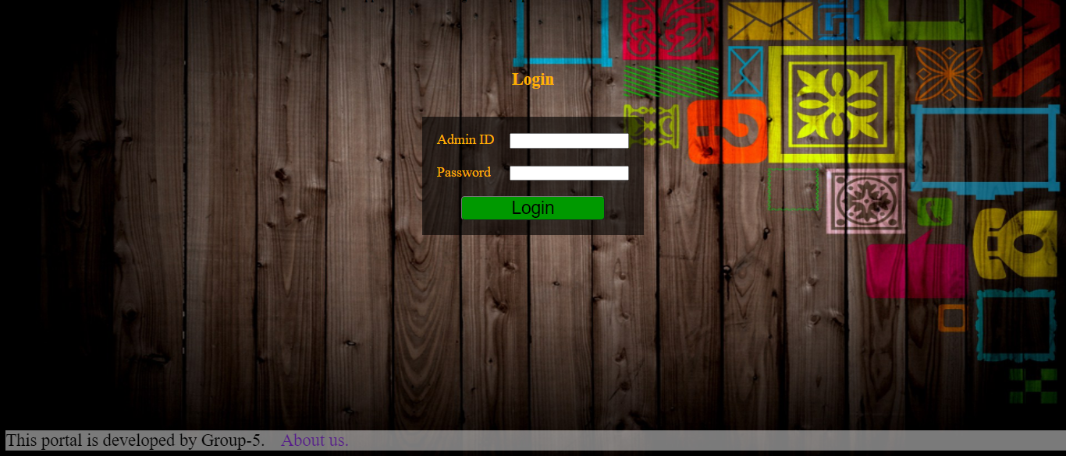
Project Screenshots

Slide 8
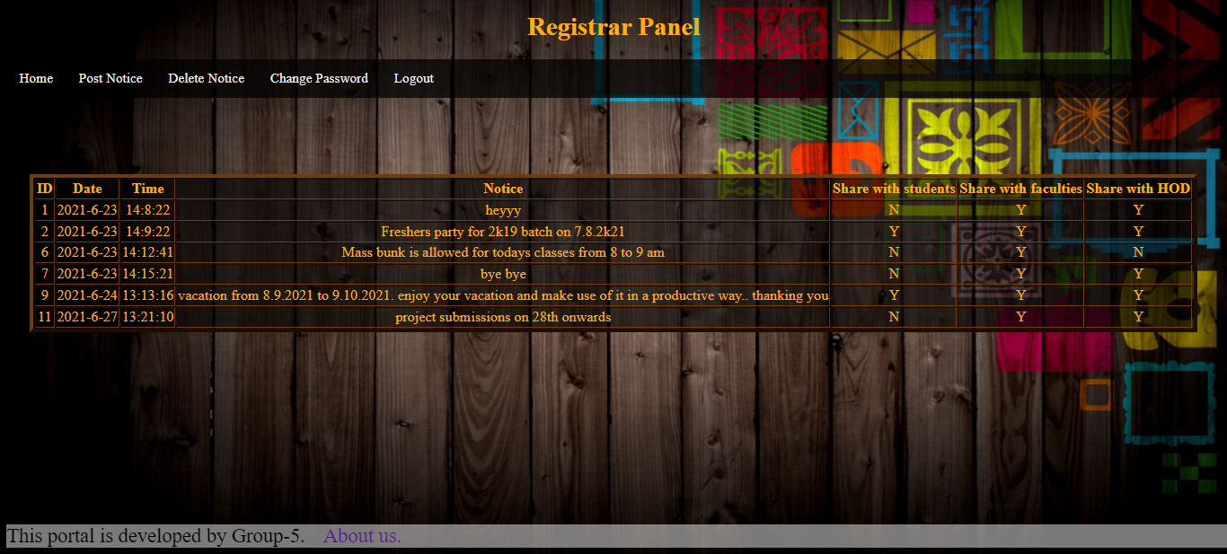
Project Screenshots

Slide 9
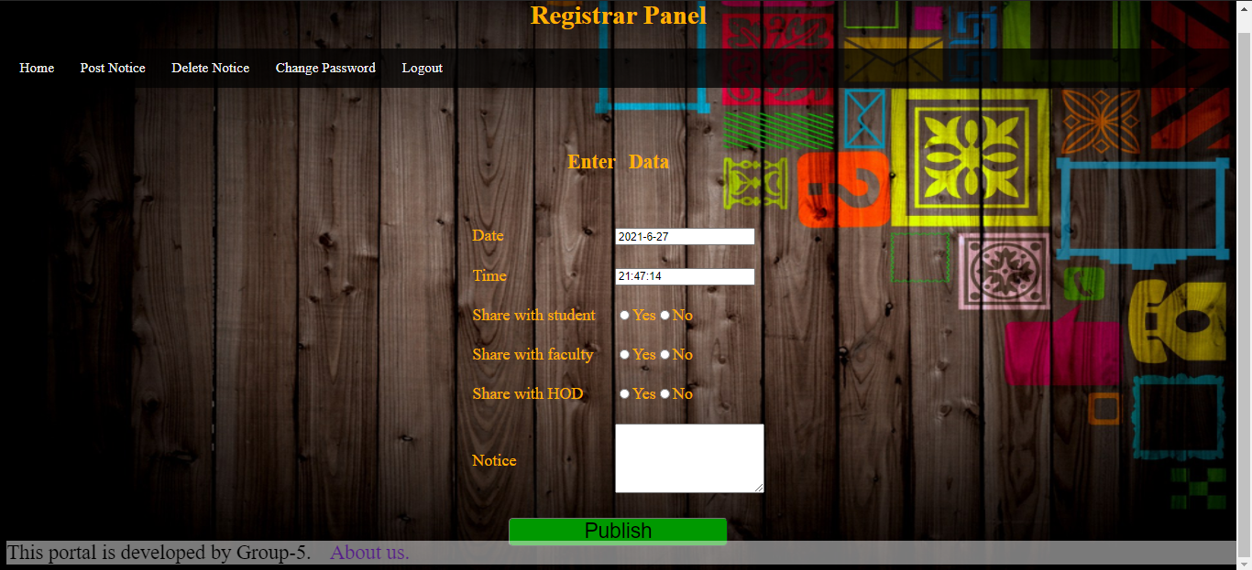
Project Screenshots

Slide 10
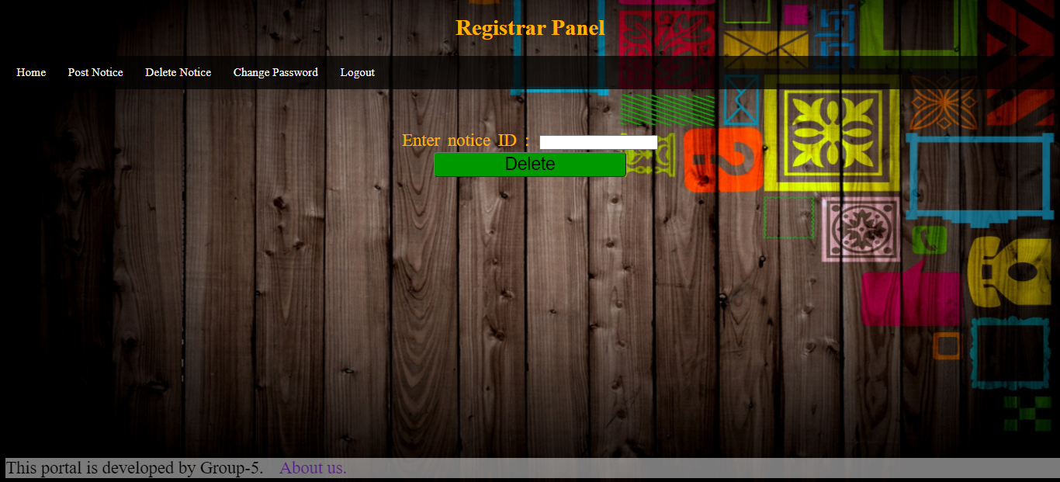
Project Screenshots

Slide 11
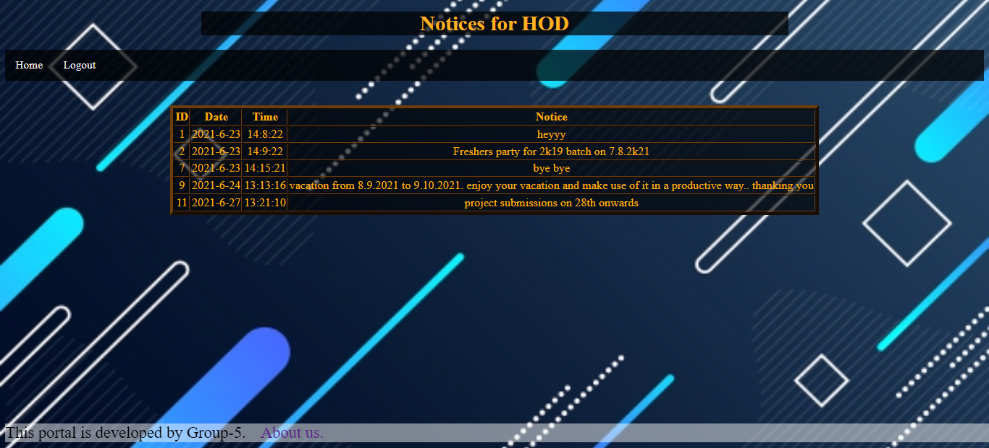
Project Screenshots

Slide 12
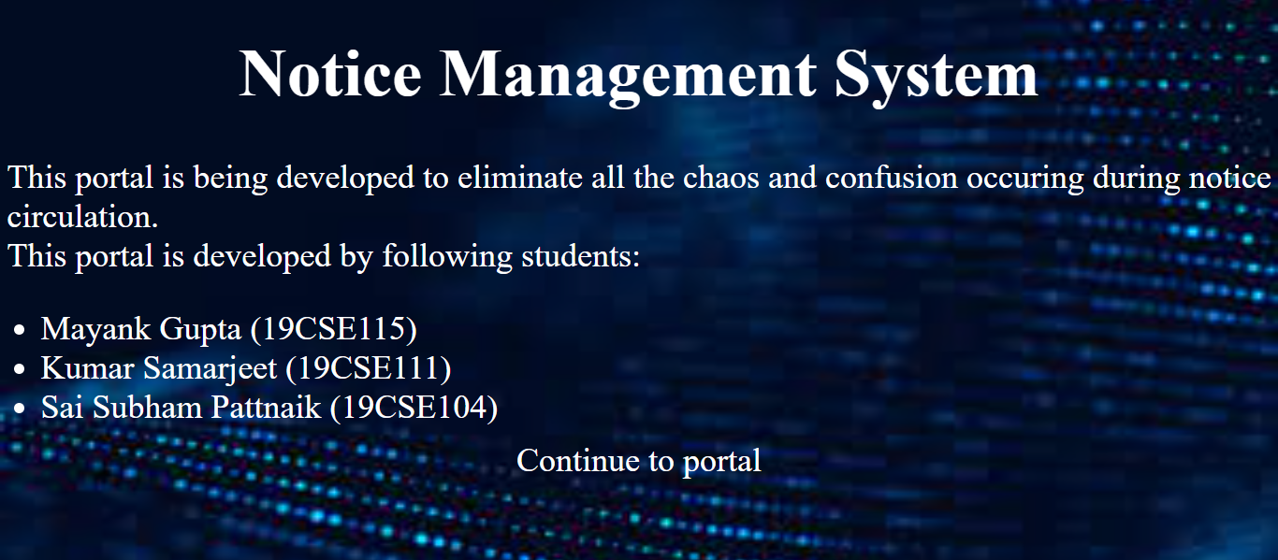
Project Screenshots

Slide 13
Conclusion and Future work
This project has helped us to get our hands free on web development tools which are HTML, CSS, php and javascript.
Looking forward to our future works, we are planning to make this portal more handy and also categorizing the system according to department-wise which will be allowing HODs to share the information in the particular department only.

Slide 14
References
Google
W3Schools
Youtube

Slide 15
Thank you…
Group – 5:-
Mayank Gupta(19CSE115)
Kumar Samarjeet(19CSE111)
Sai Subham Pattnaik(19CSE104)

